Slide 1
Backtracking, Branch & Bound
Module 2
Sem IV
AoA Even 2021-22

Slide 2
Introduction
Backtracking and Branch and Bound are two graph based methods for design of algorithms.
In both cases we explore a search tree.
In Backtracking, we start with a node and explore the nodes in Depth First manner.
All the nodes need not to be explored. Cut the branches of the tree based on the constraint of the problem. This reduces the time complexity of the algorithm.
Branch and Bound explores the search tree in a Breadth First manner.

Slide 3
Backtracking : Introduction
It is modified form of Depth First Search.
Here solution vector is of form x₁, x₂, x₃,…,x_{n} , n tuple (x₁, x₂, x₃,…,x_{n} ), where x_{i} is chosen from finite set of S_{i}, such that constraint of the problem is satisfied.
Backtracking algorithm solves the problem using two types of constraints:
Explicit Constraint
Implicit Constraint

Slide 4
Backtracking : Introduction
Terminologies Used:
Backtracking algorithms determine problem solutions by systematically searching for solution using tree structure.
State space tree: The solution space is organized as a tree called the state space tree.
Explicit constraint: These are the rules that restrict each component x_{i} of the solution vector to take values only from a given set S.
Implicit constraint: These are the rules that describe the way in which the x_{i} ’s must relate to each other or which of the components of the solution vector satisfy the criteria function.
Solution space: It is the set of all tuples that satisfy the explicit constraints.
Live node: It is the node that has been generated, but none of its descendants are yet generated.
Bounding function or criteria: It is a function created that is used to kill live nodes without generating all its children.

Slide 5
Backtracking : Introduction
Terminologies Used:
Backtracking algorithms determine problem solutions by systematically searching for solution using tree structure.
Extended node or E-node: It is the live node whose children are currently being generated.
Dead node: It is the node that is not to be extended further or all of whose children have already been generated.
Answer node: It is the node that represents the answer of the problem that means the node at which the criteria functions are maximized, minimized or satisfied.
Solution node: It is the node that has the possibility to become the answer node.

Slide 6
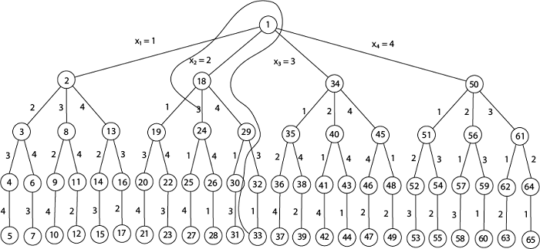
Backtracking : Introduction
Root Node
Problem State
Answer State

Slide 7
Backtracking : N-Queen Problem
2-Queen problem
3-Queen Problem
4-Queen Problem
8-Queen problem
2-Queen problem:
Therefore, No Solution
Q | x
x | x
x | Q
x | x

Slide 8
Backtracking : N-Queen Problem
2-Queen problem
3-Queen Problem
4-Queen Problem
8-Queen problem
2-Queen problem:
Therefore, No Solution
Similarly, No Solution for 3-Queen problem
Q | x
x | x
x | Q
x | x

Slide 9
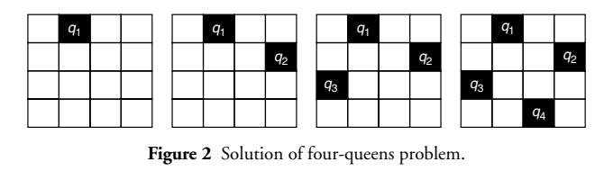
Backtracking : N-Queen Problem
4 Queen Problem:
State space Tree:

Slide 10
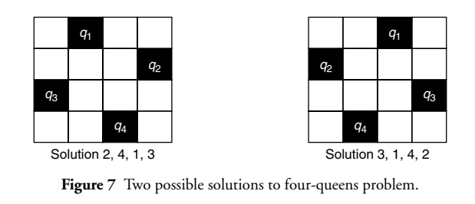
Backtracking : N-Queen Problem
4 Queen Problem:
Solution can be represented as four-tuple (x₁, x₂, x₃, x₄) where x₁ is column value in row 1 for placement of Q₁ and so on.

Slide 11
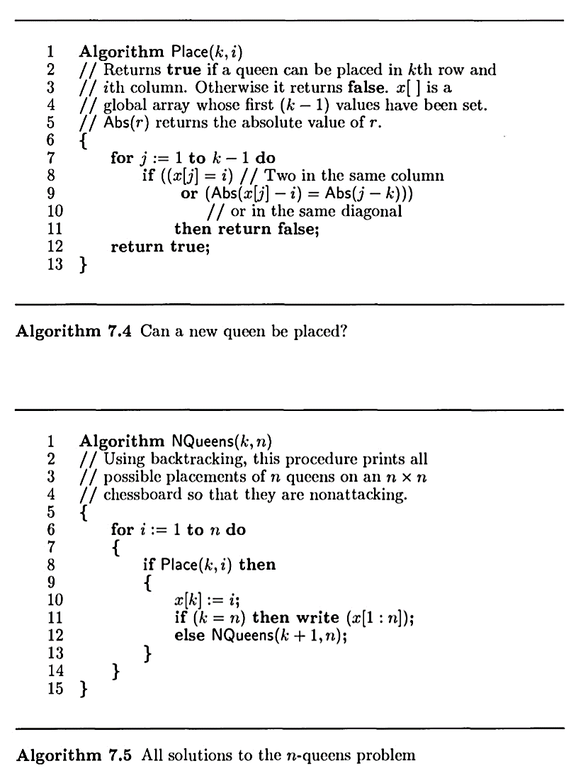
Backtracking : N-Queen Problem
N Queen Problem:

Slide 12
Backtracking : N-Queen Problem
N Queen Problem:

Slide 13
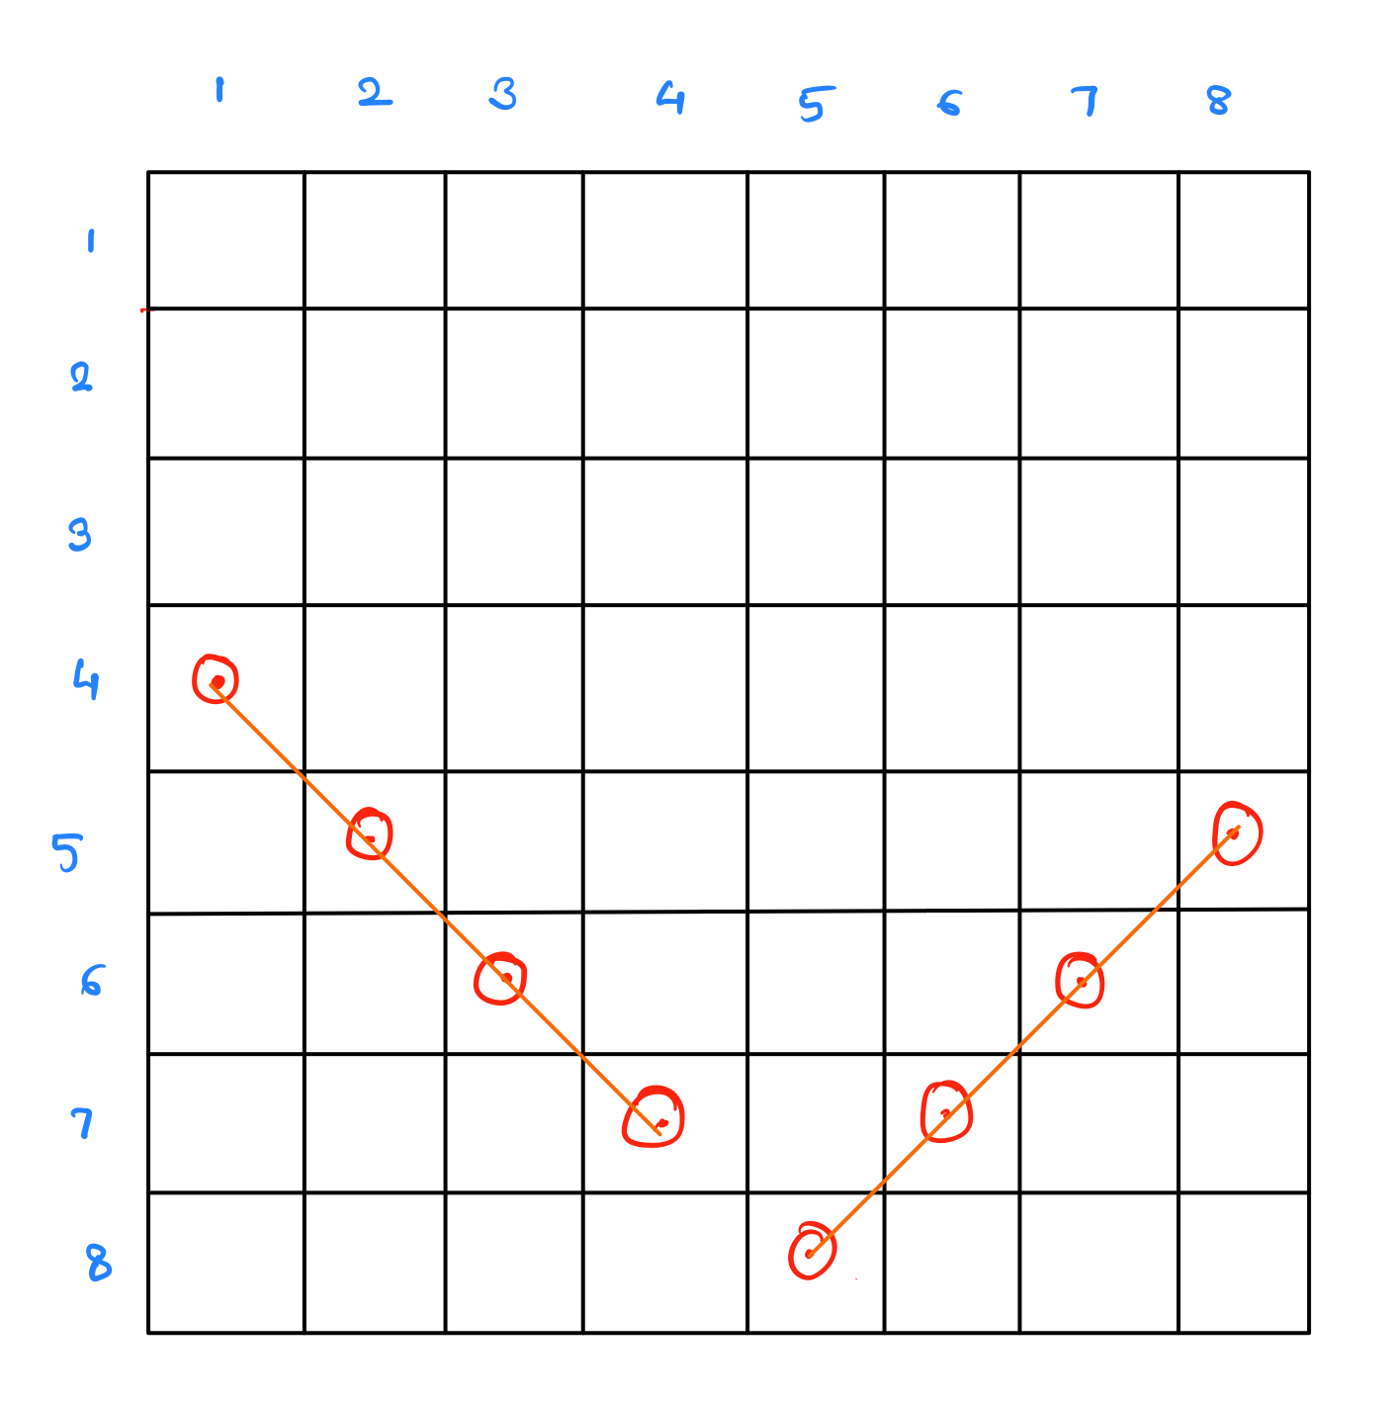
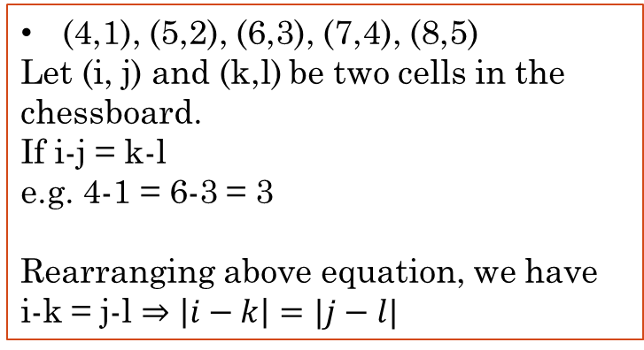
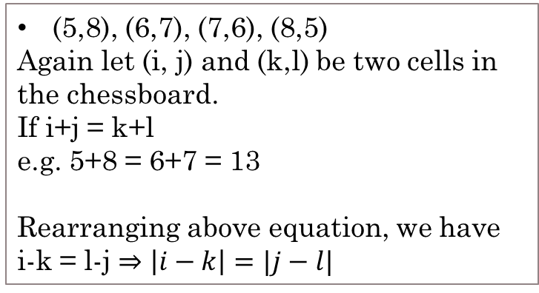
Backtracking : N-Queen Problem
N Queen Problem:
(4,1), (5,2), (6,3), (7,4), (8,5)
Let (i, j) and (k,l) be two cells in the chessboard.
If i-j = k-l
e.g. 4-1 = 6-3 = 3
Rearranging above equation, we have
i-k = j-l $⇒\left|i−k\right|=|j−l|$
(5,8), (6,7), (7,6), (8,5)
Again let (i, j) and (k,l) be two cells in the chessboard.
If i+j = k+l
e.g. 5+8 = 6+7 = 13
Rearranging above equation, we have
i-k = l-j $⇒\left|i−k\right|=|j−l|$

Slide 14

Backtracking : Sum of Subsets
Given: 1. n distinct positive numbers (called weights w_{i}), where $1≤i≤n$
2. Sum (m)
We need to find all possible subsets of given numbers (w_{i} )having sum equal to the target Sum (m).

Slide 15
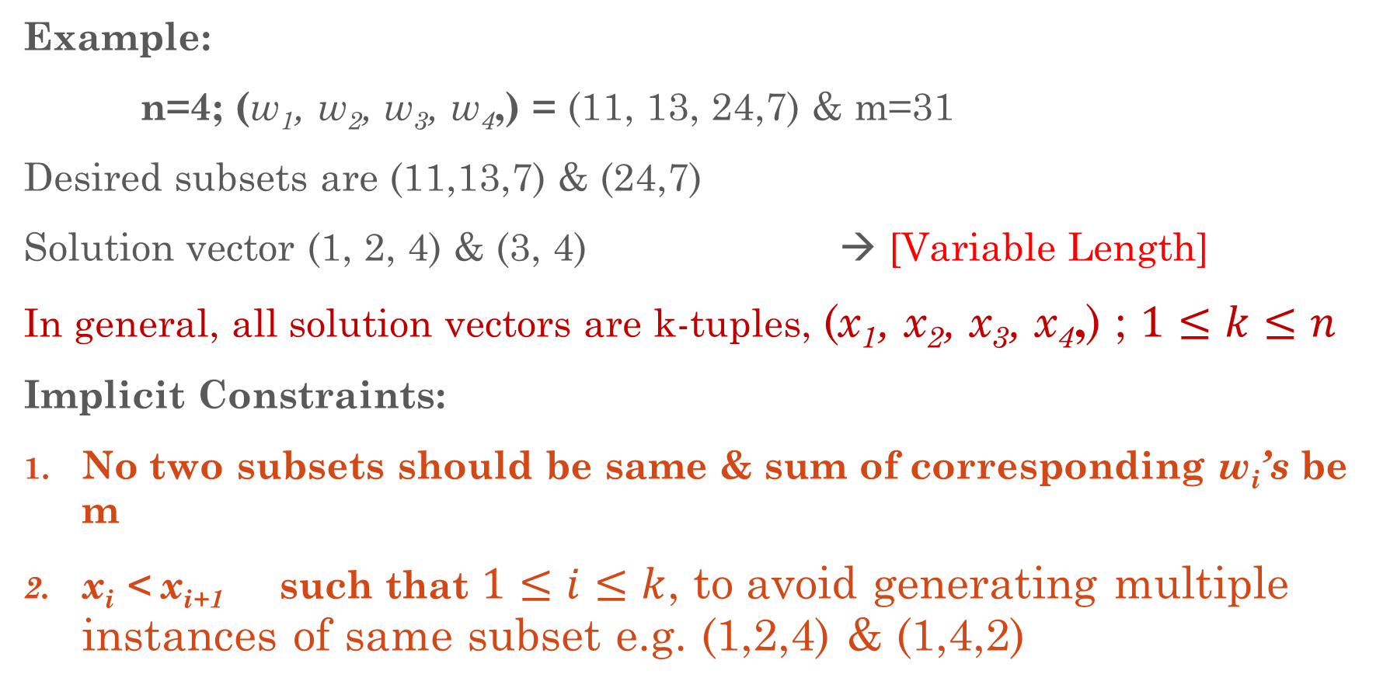
Backtracking : Sum of Subsets
Example:
n=4; (w₁, w₂, w₃, w₄,) = (11, 13, 24,7) & m=31
Desired subsets are (11,13,7) & (24,7)
Solution vector (1, 2, 4) & (3, 4) → [Variable Length]
In general, all solution vectors are k-tuples, (x₁, x₂, x₃, x₄,) ; $1≤k≤n$
Implicit Constraints:
No two subsets should be same & sum of corresponding w_{i}’s be m
x_{i} < x_{i+1} such that $1≤i≤k$, to avoid generating multiple instances of same subset e.g. (1,2,4) & (1,4,2)

Slide 16
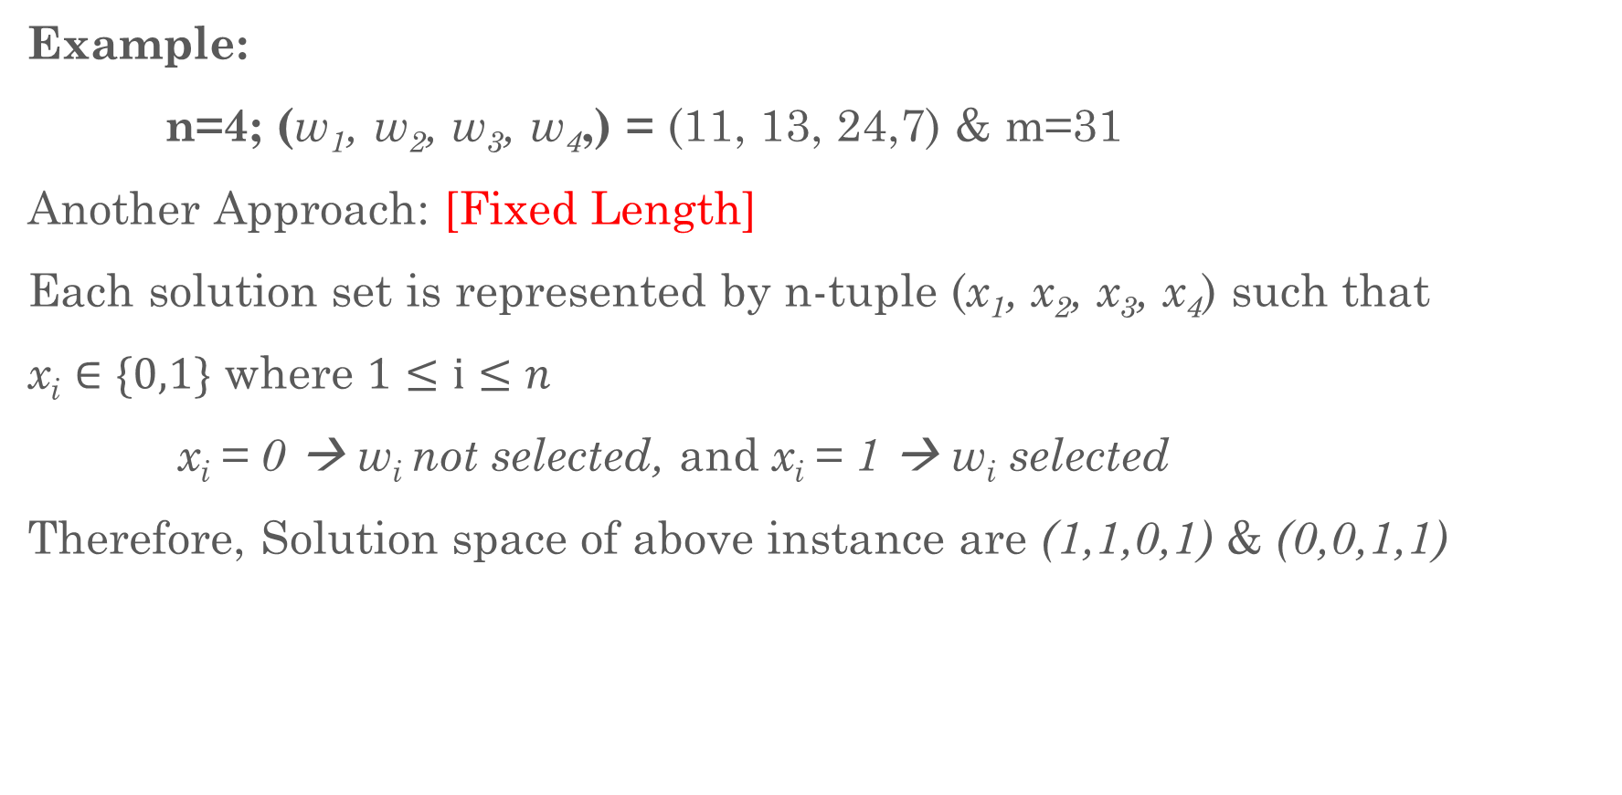
Backtracking : Sum of Subsets
Example:
n=4; (w₁, w₂, w₃, w₄,) = (11, 13, 24,7) & m=31
Another Approach: [Fixed Length]
Each solution set is represented by n-tuple (x₁, x₂, x₃, x₄) such that
x_{i} $∈\{0,1\}$ where $1≤i≤n$
x_{i} = 0 → w_{i} not selected, and x_{i} = 1 → w_{i} selected
Therefore, Solution space of above instance are (1,1,0,1) & (0,0,1,1)

Slide 17
Backtracking : Sum of Subsets
Example:
n=4; (w₁, w₂, w₃, w₄,) = (11, 13, 24,7) & m=31
Another Approach: [Fixed Length]
Each solution set is represented by n-tuple (x₁, x₂, x₃, x₄) such that
x_{i} $∈\{0,1\}$ where $1≤i≤n$
x_{i} = 0 → w_{i} not selected, and x_{i} = 1 → w_{i} selected
Therefore, Solution space of above instance are (1,1,0,1) & (0,0,1,1)

Slide 18
Backtracking : Sum of Subsets
Example:
S = {2, 3, 5, 6, 7, 9, 10} & M= 15
In state space tree of solution, node list values of
sumSoFar, k & remWeight
Initialize root node with values, sumSoFar = 0, k= 1 & remWeight= 42
0 | 1 | 42

Slide 19
Backtracking : Sum of Subsets
Example:
0 | 1 | 42
x₁=1
x₁=0
2 | 2 | 40
0 | 2 | 40
x₂=1
x₂=0
5 | 3 | 37
2 | 3 | 37
x₃=1
x₃=0
10 | 4 | 32
5 | 4 | 32
x₄=1
x₄=0
10+6>15
5 | 5 | 26
11 | 5 | 26
S = {2, 3, 5, 6, 7, 9, 10} & M= 15
11+7>15

Slide 20
Backtracking : Sum of Subsets
5 | 5 | 26
x₅=1
x₅=0
12 | 6 | 19
5 | 6 | 19
x₆=1
x₆=0
12+9>15
14 | 7 | 10
5 | 7 | 10
x₇=1
14+10>15
15 | 8 | 0
S = {2, 3, 5, 6, 7, 9, 10} & M= 15

Slide 21
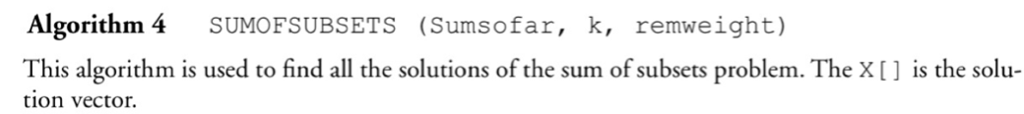
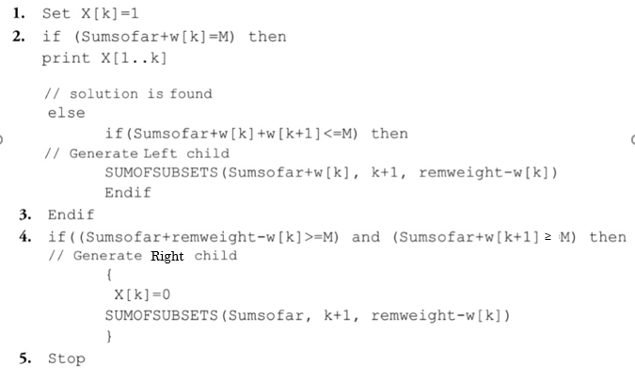
Backtracking : Sum of Subset

Slide 22
Backtracking : Graph Coloring
It’s a classic combinatorial Problem
It’s a problem of coloring N vertices of a given graph G in such a way that no two adjacent vertices share the same color and yet M colors are used.
The problem is called as M coloring problem.
M coloring Decision problem: M is given, whether graph can be colored using M colors
M coloring optimization problem: smallest number of colors (M) required to color the graph.

Slide 23
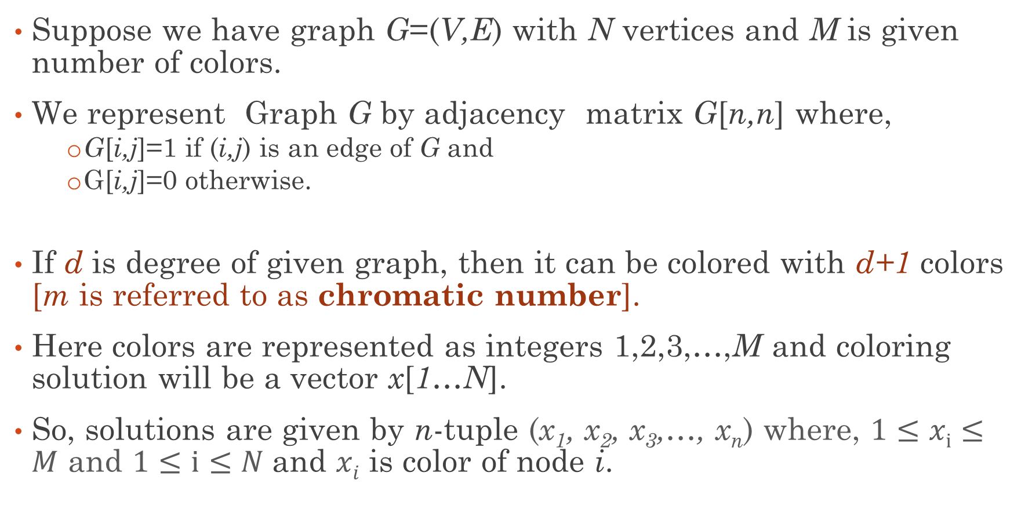
Backtracking : Graph Coloring Algorithm
Suppose we have graph G=(V,E) with N vertices and M is given number of colors.
We represent Graph G by adjacency matrix G[n,n] where,
G[i,j]=1 if (i,j) is an edge of G and
G[i,j]=0 otherwise.
If d is degree of given graph, then it can be colored with d+1 colors [m is referred to as chromatic number].
Here colors are represented as integers 1,2,3,…,M and coloring solution will be a vector x[1…N].
So, solutions are given by n-tuple (x₁, x₂, x₃,…, x_{n}) where, $1≤xi≤M$ and $1≤i≤N$and $xi$ is color of node i.

Slide 24
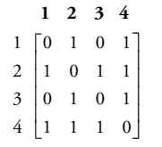
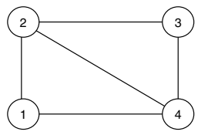
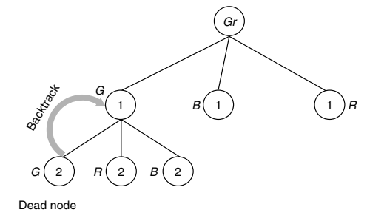
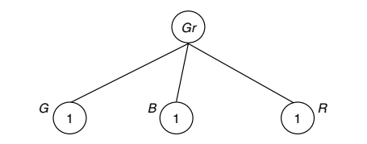
Backtracking : Graph Coloring Example
Example 1:
State Space Tree:

Slide 25
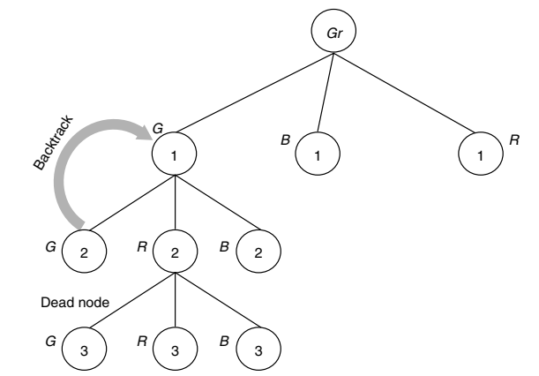
Backtracking : Graph Coloring Example

Slide 26
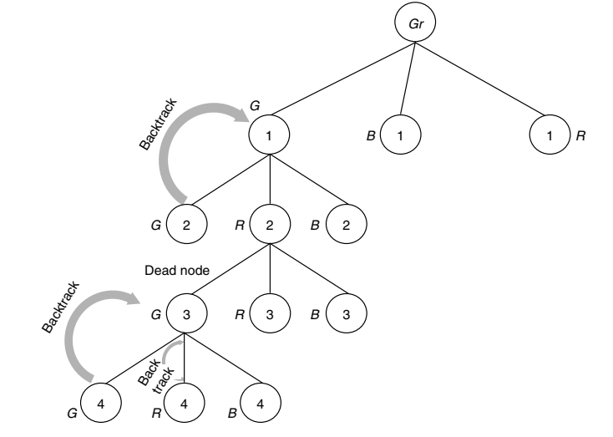

Backtracking : Graph Coloring Example
$$\{G, R, G, B\}$$

Slide 27
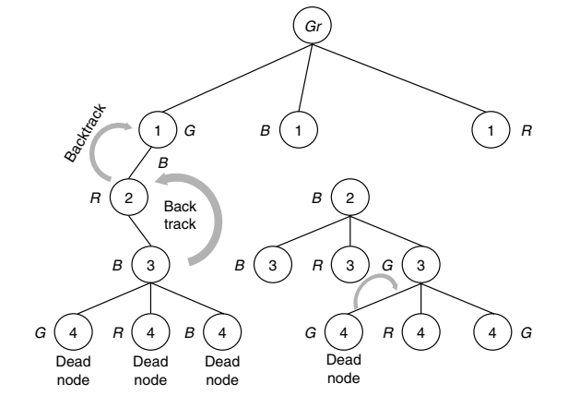
Backtracking : Graph Coloring Example

Slide 28
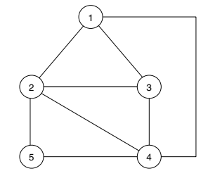
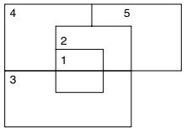
Backtracking : Graph Coloring Example
Example 2:
Map
Planer Graph

Slide 29
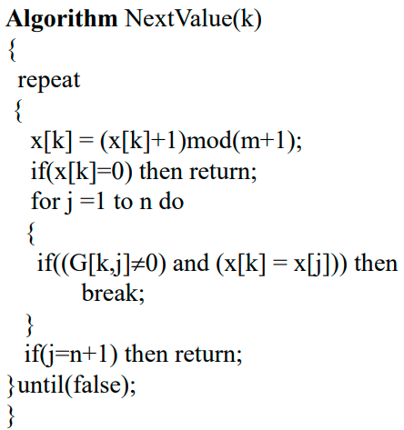
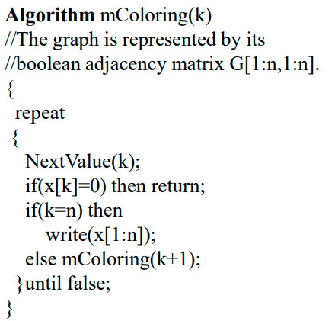
Backtracking : Graph Coloring Algorithm

Slide 30
Branch & Bound : Introduction
Branch: using State Space Tree (Similar to Backtracking)
Bound: using Upper and Lower bounds
Branch and Bound differs from backtracking in the sense that all the children of the E-Node are generated before any other live node becomes the E-Node.
Branch and Bound is the generalization of both graph search strategies, BFS and DFS.
The state space tree of the branch and bound method can be constructed using following three strategies:
FIFO (First In First Out) search (Implemented using QUEUE)
LIFO (Last In First Out) search (Implemented using STACK)
LC (Least Cost) search (Implemented using PRIORITY QUEUE)

Slide 31
Branch & Bound : Introduction
FIFO (First In First Out) Branch and Bound
In FIFO search, queue data structure is used.
Initially node 1 is taken as the E-node.
The child nodes of node 1 are generated. All these live nodes are placed in a queue.
Next the first element in the queue is deleted, i.e. node 2, the child nodes of node 2 are generated and placed in the queue.
This continues until the answer node is found.

Slide 32
Branch & Bound : FIFO
LIFO (Last In First Out) Branch and Bound
Example: Job sequencing with deadlines problem
Jobs = {J1, J2, J3, J4}; P = {10, 5, 8, 3}; d = {1, 2, 1, 2}
Node 1 is the E-node. Child nodes of node 1 are generated and placed in the queue.
First element in the queue is deleted, ie., 2 is deleted and its child nodes are generated.
Similarly, the next element is deleted, ie., 3 and its child nodes are generated and placed in the queue. This is continued until an answer node is reached.
2 | 3 | 4 | 5
3 | 4 | 5 | 6 | 7 | 8

Slide 33
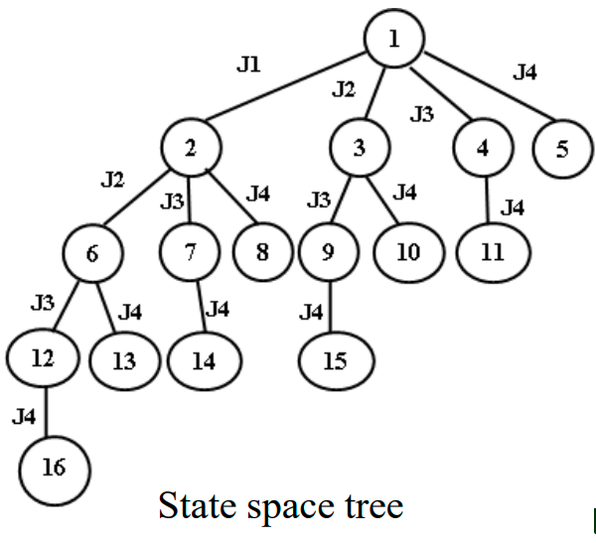
Branch & Bound : FIFO
FIFO (First In First Out) Branch and Bound
Example: Job sequencing with deadlines problem
Jobs = {J1, J2, J3, J4}; P = {10, 5, 8, 3}; d = {1, 2, 1, 2}
Node 1 is the E-node. Child nodes of node 1 are generated and placed in the queue.
First element in the queue is deleted, ie., 2 is deleted and its child nodes are generated.
Similarly, the next element is deleted, ie., 3 and its child nodes are generated and placed in the queue. This is continued until an answer node is reached.
2 | 3 | 4 | 5
3 | 4 | 5 | 6 | 7 | 8

Slide 34
Branch & Bound : LIFO
LIFO (Last In First Out) Branch and Bound
In LIFO search, stack data structure is used.
Initially node 1 is taken as the E-node.
The child nodes of node 1 are generated. All these live nodes are placed in a stack.
Next the first element in the stack is deleted, i.e. node 5, the child nodes of node 5 are generated and placed in the stack.
This continues until the answer node is found.

Slide 35
Branch & Bound : LIFO
LIFO (Last In First Out) Branch and Bound
Example: Job sequencing with deadlines problem
Jobs = {J1, J2, J3, J4}; P = {10, 5, 8, 3}; d = {1, 2, 1, 2}
Node 1 is the E-node. Child nodes of node 1 are generated and placed in the stack.
First element in the stack is deleted, i.e., 5 is deleted and its child nodes are generated.
Similarly, the next element is deleted, i.e., 4 and its child nodes are generated and placed in the queue. This is continued until an answer node is reached.
5
4
3
2
4
3
2
6
3
2

Slide 36
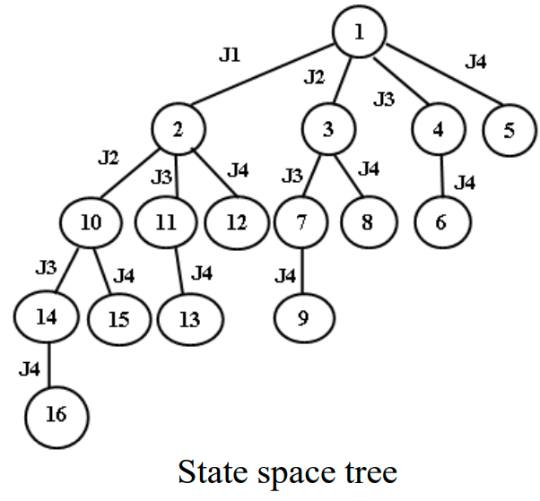
Branch & Bound : LIFO
FIFO (First In First Out) Branch and Bound
Example: Job sequencing with deadlines problem
Jobs = {J1, J2, J3, J4}; P = {10, 5, 8, 3}; d = {1, 2, 1, 2}
Node 1 is the E-node. Child nodes of node 1 are generated and placed in the stack.
First element in the stack is deleted, i.e., 5 is deleted and its child nodes are generated.
Similarly, the next element is deleted, i.e., 4 and its child nodes are generated and placed in the queue. This is continued until an answer node is reached.

Slide 37
Branch & Bound : LCBB
LC (Least Count) Branch and Bound:
In both FIFO and LIFO Branch and Bound the selection rules for the next E-node in rigid and blind.
The selection rule for the next E-node does not give any preferences to a node that has a very good chance of getting the search to an answer node quickly.
In this method ranking function or cost function is used.
The child nodes of the E-node are generated, among these live nodes; a node which has minimum cost is selected. By using ranking function, the cost of each node is calculated.

Slide 38
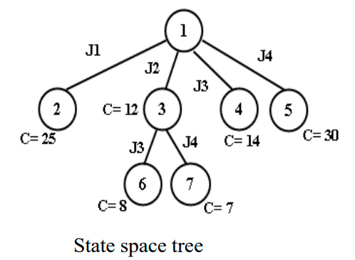
Branch & Bound : LCBB
LC (Least Count) Branch and Bound:
Example: Job sequencing with deadlines problem
Jobs = {J1, J2, J3, J4}; P = {10, 5, 8, 3}; d = {1, 2, 1, 2}
Initially we will take node 1 as E-node. Generate children of node 1, the children are 2, 3, 4, 5. By using ranking function we will calculate the cost of 2, 3, 4, 5 nodes is ĉ =25, ĉ =12, ĉ =14, ĉ =30 respectively.
Now we will select a node which has minimum cost i.e., node 3. For node 3, the children are 6, 7.

Slide 39
Branch & Bound : LCBB
LC (Least Count) Branch and Bound:
All the live nodes are stored in a PRIORITY QUEUE or HEAP.
The live nodes are not selected according to the order in which they have been queued or stacked but according to their heuristic value.
The heuristic value is calculated for each live node and then the node with the highest heuristic value is chosen as the E-node.

Slide 40

Branch & Bound : 0/1 Knapsack Problem
LC (Least Count) Branch and Bound:
The 0/1 knapsack problem is to
objective of this problem is to fill the knapsack in order to maximize the profit subject to its capacity.
But Branch & Bound is used for minimization problem.

Slide 41
Branch & Bound : 0/1 Knapsack Problem
LC (Least Count) Branch and Bound:
This modified knapsack problem is stated as,
The 0/1 knapsack problem is the maximization problem where the value of the objective function ĉ(x) = ∑p_{i} x_{i} is maximized subjected to ∑ w_{i}x_{i} ≤ M,
Now our aim is minimization, so we take the objective function ĉ(x) = − ∑pi xi subjected to ∑ w_{i}x_{i} ≤ M in order to convert the 0/1 knapsack problem as the minimization problem where xi = 0 or 1, 1 ≤ i ≤ n
The two functions ĉ(x) and U(x) are defined using two algorithms Bound and UBound .

Slide 42

Branch & Bound : 0/1 Knapsack Problem
LC (Least Count) Branch and Bound:
UBound computes the weights of the list of objects placed in the knapsack as a whole and their sum $≤$m, and the profit is correspondingly decremented from initial profit and returned.
Bound is similar to UBound but it considers fractional objects to use the entire capacity of the sack Σw_{i}x_{i} = m.

Slide 43
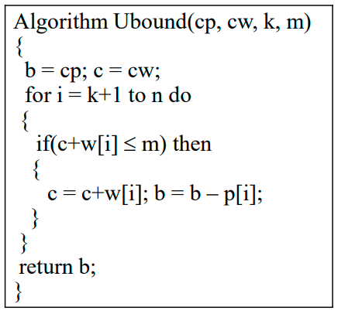
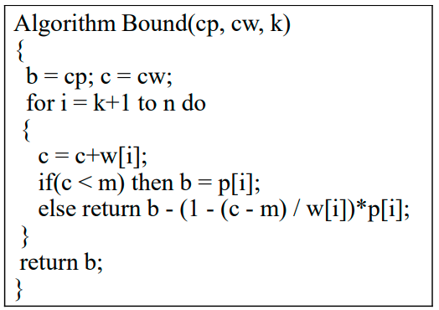
Branch & Bound : 0/1 Knapsack Problem
Algorithm:

Slide 44
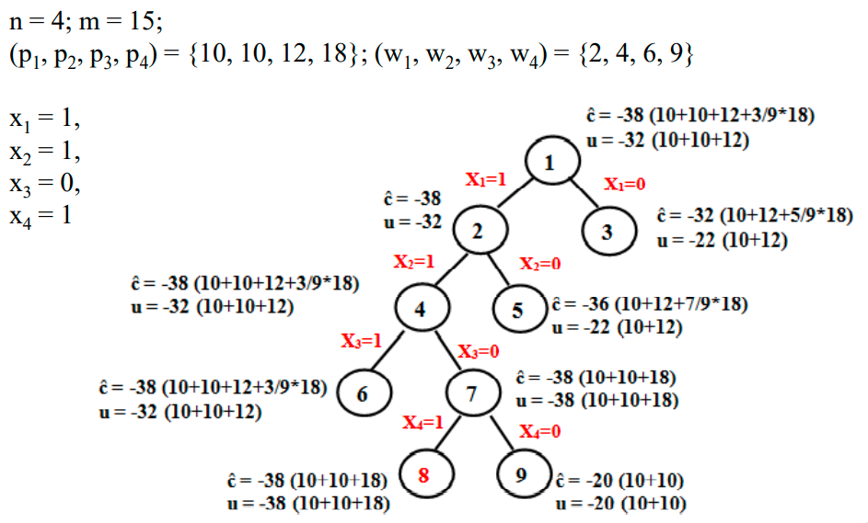
Branch & Bound : 0/1 Knapsack Problem

Slide 45
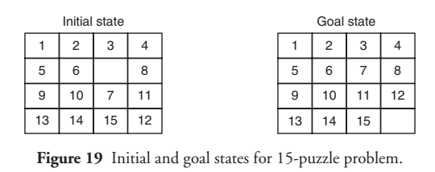
Branch & Bound : 15 Puzzle Problem
The 15 Puzzle problem is invented by Sam Loyd in 1878.
The problem consist of 15 numbered (0-15) tiles on a square box with 16 tiles(one tile is blank or empty).
The objective of this problem is to change the arrangement of initial node to goal node by using series of legal moves.
The Initial and Goal node arrangement is shown by following figure

Slide 46
Branch & Bound : 15 Puzzle Problem
In initial node four moves are possible. User can move any one of the tile like 2,or 3, or 5, or 6 to the empty tile. From this we have four possibilities to move from initial node.
The legal moves are for adjacent tile number is left, right, up, down, ones at a time.
Each and every move creates a new arrangement, and this arrangement is called state of puzzle problem.
By using different states, a state space tree diagram is created, in which edges are labeled according to the direction in which the empty space moves.
The LCBB method is the general method used to solve the 15-puzzle problem so that the goal state can be achieved in minimum number of tile movement.

Slide 47
Branch & Bound : 15 Puzzle Problem
In state space tree, nodes are numbered as per the level. In each level we must calculate the value or cost of each node by using given formula:
C(x)=f(x)+g(x),
f(x) is length of path from root or initial node to node x,
g(x) is estimated length of path from x downward to the goal node. Number of non-blank tile not in their correct position.
C(x)< Infinity.(initially set bound).
Each time node with smallest cost is selected for further expansion towards goal node. This node become the e-node.

Slide 48
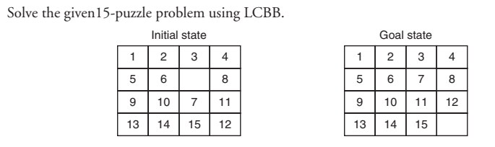
Branch & Bound : 15 Puzzle Problem
Example:

Slide 49
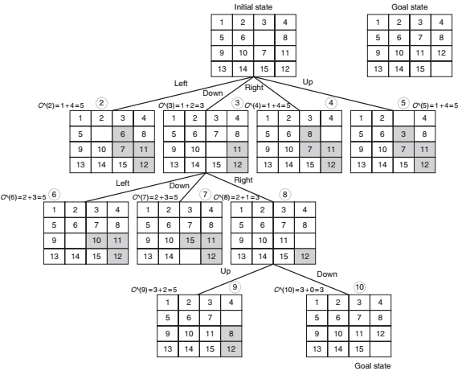
Branch & Bound : 15 Puzzle Problem
Example:

